Slide 1
Big Mountain Resort
Data Analysis For Increased Revenue

Slide 2
Problem Identification
Big Mountain Resort recently installed a new chair lift to increase distribution of visitors across the mountain
Operating costs have now increased by $1.5M
The resort is not capitalizing on its resources
How can we use the data to identify assets and capitalize on these strengths/facilities to increase revenue for the season?
Can the data justify an increase in ticket prices?

Slide 3
Recommendation
The data proved that Big Mountain Resort is near the top in every feature that was deemed valuable for ticket pricing
Raising the price from $81 to $90 will increase revenue by a staggering $15M
This easily offsets the operating costs of the new lift and will provide financial stability
Scenario 2 provided by the business also is expected to support an additional $9 raise
If this direction is taken, revenue can be again increased by $15M

Slide 4
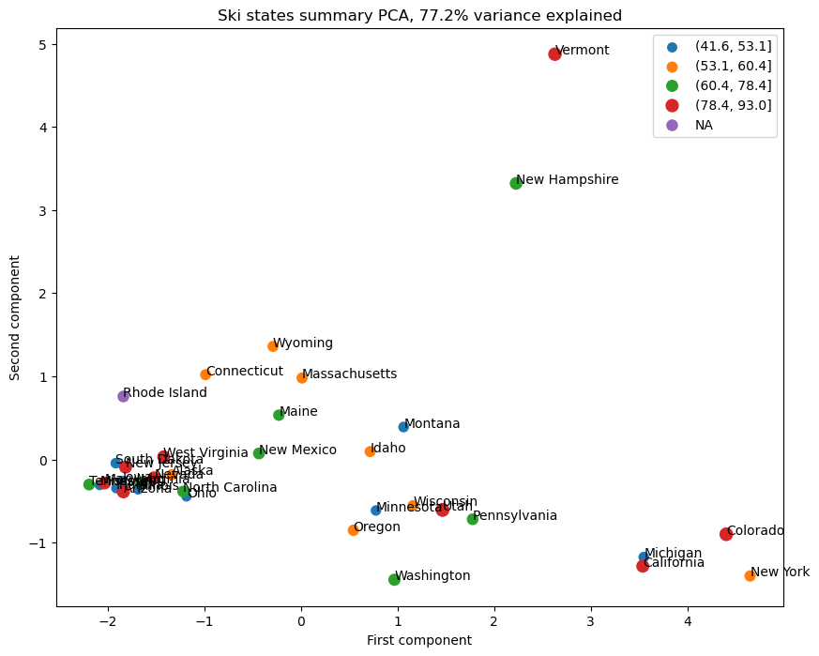
State vs Pricing
Using principle components analysis it was determined that there was no obvious pattern between state and ticket pricing so all states were treated equal in the pricing model

Slide 5
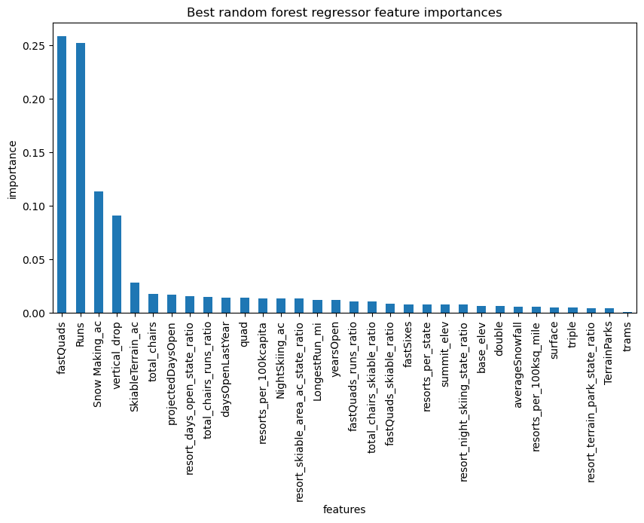
Valued Features
A random forest regressor highlighted the top four features:
Fast Quads
Number of Runs
Amount of Snow Making
Vertical Drop

Slide 6
Price Point
Using the random forest model we created, the modelled price is $95.87 while the current price is at $81
The expected mean absolute error is at $10.39
These two findings suggest that ticket pricing should at the minimum be set at $90

Slide 7
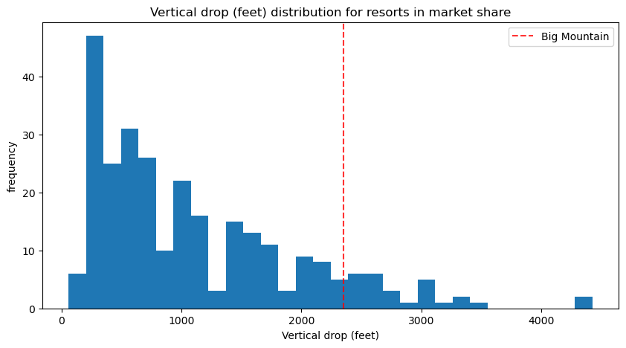
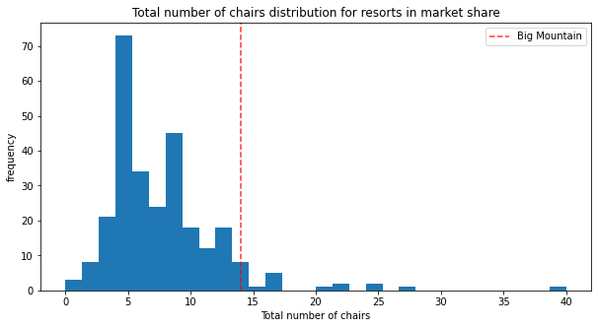
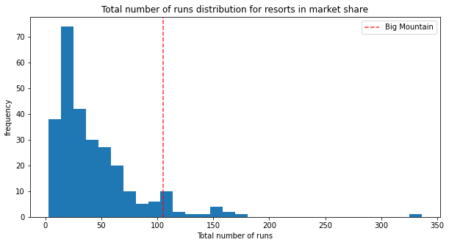
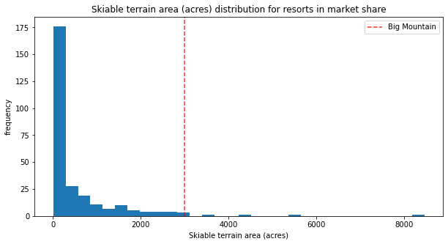
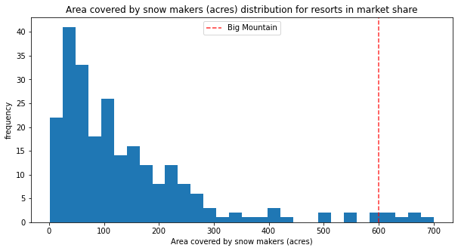
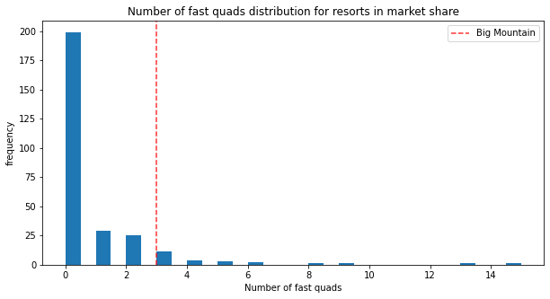
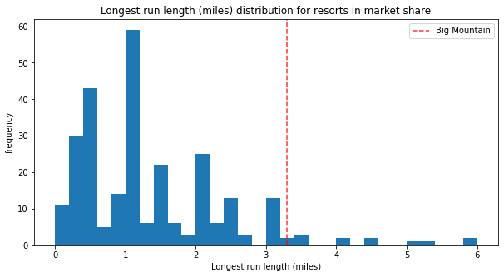
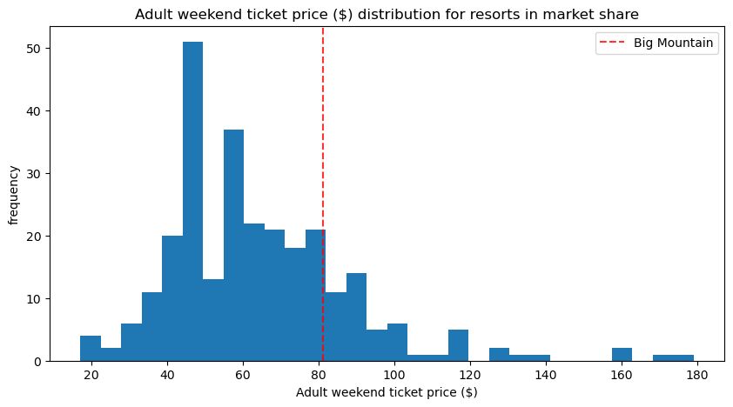
Resort Rankings
Of the identified features, BIg Mountain Resort ranks towards the top in many features

Slide 8
Scenario Two
The business suggested four options for increasing revenue
Only scenario two proved to profitable
Scenario Two included:
Increasing vertical drop by 150 ft
Adding an additional chair lift
Taking into account an average of 350,000 visitors that ski for five days, the model supports a raise in price of $8.61 which is expected to increase revenue by $15M

Slide 9
Conclusion
It is clear that Big Mountain Resort has been undervaluing their features/facilities
They rank very high in nearly all categories and the data proves there is room for a raise in ticket pricing
By increasing to $90/ticket, the $15M expected in revenue over the season will go a long way in further improving the resort
Scenario two was also shown to provide great financial return if management is interested in pursuing that option in the future
Thank you for your time and opportunity!

